Slide 1

Type Conversions

Slide 2

Type Conversions
  The type conversions are automatic only when the data types involved are built-in types.
    int m;
    float x = 3.14159;
    m = x; // convert x to integer before its value is assigned
    // to m.
  For user defined data types, the compiler does not support automatic type conversions.
  We must design the conversion routines by ourselves.

Slide 3
Type Conversions
continue…
  Different situations of data conversion between incompatible types.
  Conversion from basic type to class type.
  Conversion from class type to basic type.
  Conversion from one class type to another class type.

Slide 4
Basic to Class Type
  A constructor to build a string type object from a char * type variable.
  string : : string(char *a)
  {
  length = strlen(a);
  P = new char[length+1];
  strcpy(P,a);
  }
  The variables length and p are data members of the class string.

Slide 5
Basic to Class Type
continue…
  string s1, s2;
  char* name1 = “IBM PC”;
  char* name2 = “Apple Computers”;
  s1 = string(name1);
  s2 = name2;
First converts name1 from char* type to string type and then assigns the string type value to the object s1.
First converts name2 from char* type to string type and then assigns the string type value to the object s2.

Slide 6
Basic to Class Type
continue…
  Example of converting an int type to class type :-
  class time
  { int hrs ;
  int mins ;
  public :
  …
  time (int t) //constructor
  {
  hrs = t / 60 ; // t in minutes
  mins = t % 60;
  }
  } ;
  time T1; // Object T1 created
  int duration = 85;
  T1 = duration; // int to class type
Conversion statement can be used in function

Slide 7
Class To Basic Type
  A constructor function do not support type conversion from a class type to a basic type.
  An overloaded casting operator is used to convert a class type data to a basic type.
  It is also referred to as conversion function.
  operator typename( )
  {
  …
  … ( function statements )
  …
  }
  This function converts a calss type data to typename.

Slide 8
Class To Basic Type
continue…
  Consider following conversion function
  vector : : operator double( )
  {
  double sum = 0;
  for (int i=0; i < size ; i++)
  sum = sum + v[i] * v[i];
  return sqrt (sum);
  }
This function converts a vector to the corresponding scalar magnitude.
Recall that, Magnitude of a Vector is given by the square root of the sum of squares of its components.

Slide 9
Class To Basic Type
continue…
  The operator double ( ) can be used as follows
  double length = double ( V1 );
  Or
  double length = V1;
  Where V1, is an object of type vector. Both statement have gives same effects.
  When compiler encounters a statement that requires the conversion of a class type to be basic type, it quietly calls the casting operator function to do the job.

Slide 10
Class To Basic Type
continue…
  The casting operator function should satisfy the following conditions:
  It must be a class member.
  It must not specify a return type.
  It must not have any arguments.

Slide 11
Class To Basic Type
continue…
  Conversion functions are member functions and so, invoked with objects.
  Therefore the values used for conversion inside the function belong to the object that invoked the function.
  This means that the function does not need an argument.

Slide 12
One Class To Another Class Type
  objX = objY ; // objects of different types
  objX is an object of class X and objY is an object of class Y.
  The class Y type data is converted to the class X type data and the converted value is assigned to the objX.
  Conversion is takes place from class Y to class X.
  Y is known as source class.
  X is known as destination class.

Slide 13
One Class To Another Class Type
continue…
  Conversion between objects of different classes can be carried out by either a constructor or a conversion function.
  Choosing of constructor or the conversion function depends upon where we want the type-conversion function to be located in the source class or in the destination class.

Slide 14
One Class To Another Class Type
continue…
  operator typename( )
  Converts the class object of which it is a member to typename.
  The typename may be a built-in type or a user-defined one.
  In the case of conversions between objects, typename refers to the destination class.
  When a class needs to be converted, a casting operator function can be used at the source class.
  The conversion takes place in the source class and the result is given to the destination class object.

Slide 15
One Class To Another Class Type
continue…
  Consider a constructor function with a single argument
  Construction function will be a member of the destination class.
  The argument belongs to the source class and is passed to the destination class for conversion.
  The conversion constructor be placed in the destination class.

Slide 16
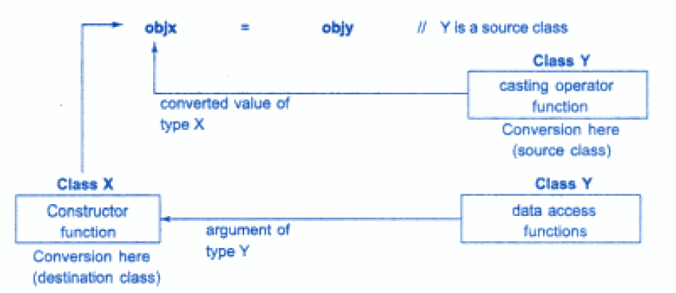
Conversion Between Object
Fig:- Illustrates these two approaches

Slide 17
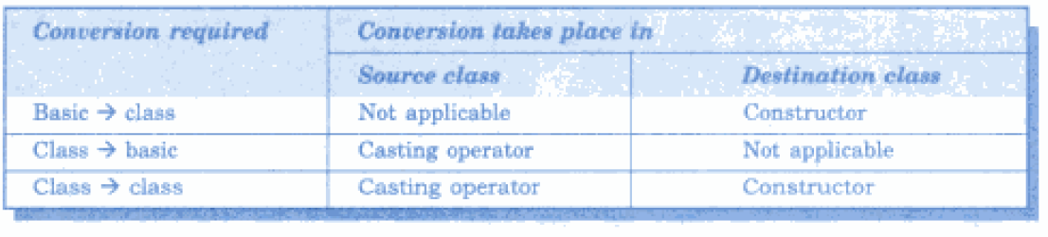
Type Conversion Table
Fig:- Summary of all three conversions

Slide 18
Thank You

